Slide 1
AES Advanced Encrypt
Standard in java
NAVY
2017.12.11
16040009 kim joon su

Slide 2
contents
001 AES 128 bit Structure
encrypt128()
decrypt128()
subBytes()
shiftRows()
MmxColumn()
addroundKey()
002 Keyschedule
003 AES CBC Mode
setPassword()
setText()
encrypt()
decrypt()

Slide 3
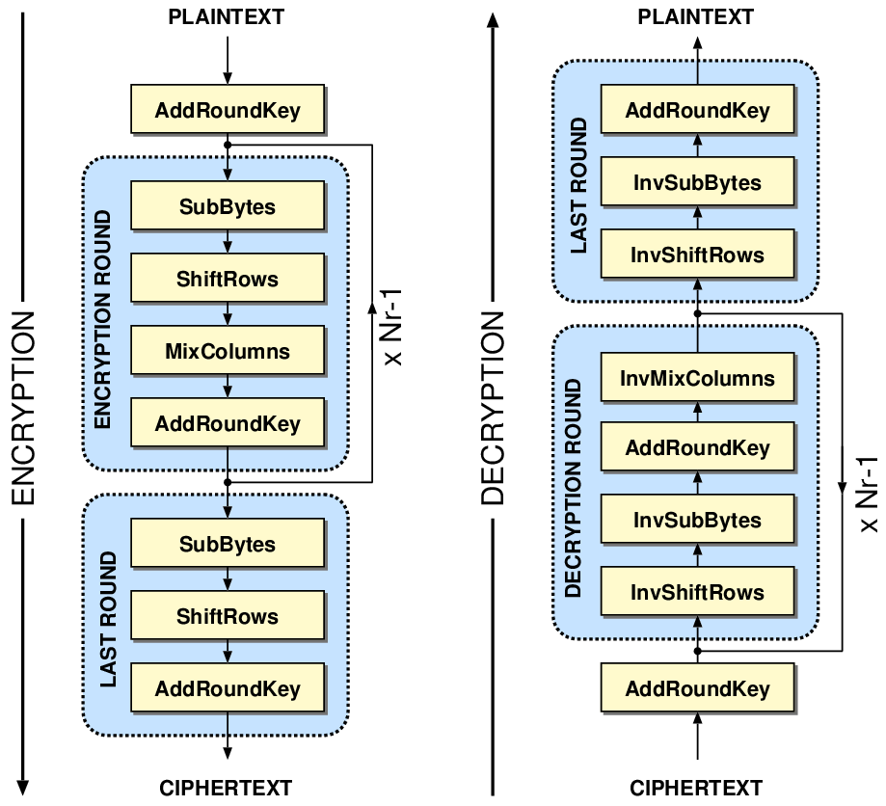
1. AES 128 Structure
1. key scheduling
2. init round
add round key
3. round (반복)
sub bytes
shift rows
mix columns
add round key
4. final round
sub bytes
shift rows
add round key

Slide 4
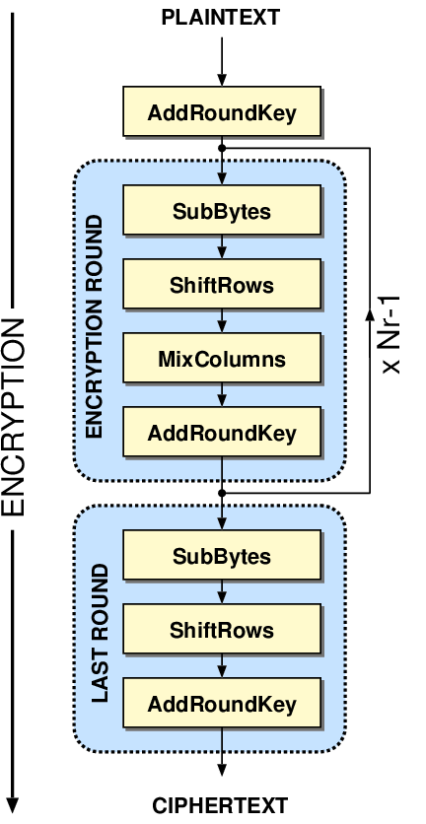
public byte[] encrypt128(byte [] arr){ addRoundKey(arr, roundKeys[0]); for(int i=1;i<10;i++){ subBytes(arr); shiftRows(arr); mixColumns(arr); addRoundKey(arr, roundKeys[i]); } subBytes(arr); shiftRows(arr); addRoundKey(arr, roundKeys[10]); return arr; }
1.1 encrypt128()
encrypt128()code

Slide 5
public byte[] decrypt128(byte [] arr){ addRoundKey(arr, roundKeys[10]); invShiftRows(arr); invSubBytes(arr); for(int i=9;i>0;i--){ addRoundKey(arr, roundKeys[i]); invMixColumns(arr); invShiftRows(arr); invSubBytes(arr); } addRoundKey(arr, roundKeys[0]); return arr; }
1.1 decrypt128()
dencrypt128()code

Slide 6
1.1 encrypte128() vs decrypt128()
public byte[] encrypt128(byte [] arr){ addRoundKey(arr, roundKeys[0]); for(int i=1;i<10;i++){ subBytes(arr); shiftRows(arr); mixColumns(arr); addRoundKey(arr, roundKeys[i]); } subBytes(arr); shiftRows(arr); addRoundKey(arr, roundKeys[10]); return arr; }
public byte[] decrypt128(byte [] arr){ addRoundKey(arr, roundKeys[10]); invShiftRows(arr); invSubBytes(arr); for(int i=9;i>0;i--){ addRoundKey(arr, roundKeys[i]); invMixColumns(arr); invShiftRows(arr); invSubBytes(arr); } addRoundKey(arr, roundKeys[0]); return arr; }
encrypt128()code
dencrypt128()code

Slide 7
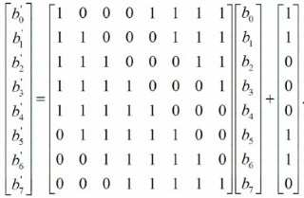
1.1 subBytes()

Slide 8
1.1 subBytes()
--- | 00 | 01 | 02 | 03 | 04 | 05 | 06 | 07 | 08 | 09 | 0A | 0B | 0C | 0D | 0E | 0F
00 | 0x63 | 0x7C | 0x77 | 0x7B | 0xF2 | 0x6B | 0x6F | 0xC5 | 0x30 | 0x01 | 0x67 | 0x2B | 0xFE | 0xD7 | 0xAB | 0x76
10 | 0xCA | 0x82 | 0xC9 | 0x7D | 0xFA | 0x59 | 0x47 | 0xF0 | 0xAD | 0xD4 | 0xA2 | 0xAF | 0x9C | 0xA4 | 0x72 | 0xC0
20 | 0xB7 | 0xFD | 0x93 | 0x26 | 0x36 | 0x3F | 0xF7 | 0xCC | 0x34 | 0xA5 | 0xE5 | 0xF1 | 0x71 | 0xD8 | 0x31 | 0x15
30 | 0x04 | 0xC7 | 0x23 | 0xC3 | 0x18 | 0x96 | 0x05 | 0x9A | 0x07 | 0x12 | 0x80 | 0xE2 | 0xEB | 0x27 | 0xB2 | 0x75
40 | 0x09 | 0x83 | 0x2C | 0x1A | 0x1B | 0x6E | 0x5A | 0xA0 | 0x52 | 0x3B | 0xD6 | 0xB3 | 0x29 | 0xE3 | 0x2F | 0x84
50 | 0x53 | 0xD1 | 0x00 | 0xED | 0x20 | 0xFC | 0xB1 | 0x5B | 0x6A | 0xCB | 0xBE | 0x39 | 0x4A | 0x4C | 0x58 | 0xCF
60 | 0xD0 | 0xEF | 0xAA | 0xFB | 0x43 | 0x4D | 0x33 | 0x85 | 0x45 | 0xF9 | 0x02 | 0x7F | 0x50 | 0x3C | 0x9F | 0xA8
70 | 0x51 | 0xA3 | 0x40 | 0x8F | 0x92 | 0x9D | 0x38 | 0xF5 | 0xBC | 0xB6 | 0xDA | 0x21 | 0x10 | 0xFF | 0xF3 | 0xD2
80 | 0xCD | 0x0C | 0x13 | 0xEC | 0x5F | 0x97 | 0x44 | 0x17 | 0xC4 | 0xA7 | 0x7E | 0x3D | 0x64 | 0x5D | 0x19 | 0x73
90 | 0x60 | 0x81 | 0x4F | 0xDC | 0x22 | 0x2A | 0x90 | 0x88 | 0x46 | 0xEE | 0xB8 | 0x14 | 0xDE | 0x5E | 0x0B | 0xDB
A0 | 0xE0 | 0x32 | 0x3A | 0x0A | 0x49 | 0x06 | 0x24 | 0x5C | 0xC2 | 0xd3 | 0xAC | 0x62 | 0x91 | 0x95 | 0xE4 | 0x79
B0 | 0xE7 | 0xC8 | 0x37 | 0x6D | 0x8D | 0xD5 | 0x4E | 0xA9 | 0x6C | 0x56 | 0xF4 | 0xEA | 0x65 | 0x7A | 0xAE | 0x08
C0 | 0xBA | 0x78 | 0x25 | 0x2E | 0x1C | 0xA6 | 0xB4 | 0xC6 | 0xE8 | 0xdD | 0x74 | 0x1F | 0x4B | 0xBD | 0x8B | 0x8A
D0 | 0x70 | 0x3E | 0xB5 | 0x66 | 0x48 | 0x03 | 0xF6 | 0x0E | 0x61 | 0x35 | 0x57 | 0xB9 | 0x86 | 0xC1 | 0x1D | 0x9E
E0 | 0xE1 | 0xF8 | 0x98 | 0x11 | 0x69 | 0xD9 | 0x8E | 0x94 | 0x9B | 0x1E | 0x87 | 0xE9 | 0xCE | 0x55 | 0x28 | 0xDF
F0 | 0x8C | 0xA1 | 0x89 | 0x0D | 0xBF | 0xE6 | 0x42 | 0x68 | 0x41 | 0x99 | 0x2D | 0x0F | 0xB0 | 0x54 | 0xBB | 0x16

Slide 9
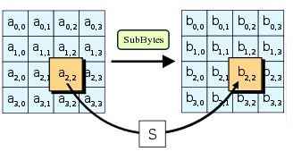
public void subBytes(byte [] arr){ for(int i=0;i<arr.length;i++){ arr[i]=(byte)Sbox[byteToint(arr[i])]; } }
1.1 subBytes()
subBytes()code

Slide 10
1.1 invSubBytes()
--- | 00 | 01 | 02 | 03 | 04 | 05 | 06 | 07 | 08 | 09 | 0A | 0B | 0C | 0D | 0E | 0F
00 | 0x52 | 0x09 | 0x6A | 0xD5 | 0x30 | 0x36 | 0xA5 | 0x38 | 0xBF | 0x40 | 0xA3 | 0x9E | 0x81 | 0xF3 | 0xD7 | 0xFB
10 | 0x7C | 0xE3 | 0x39 | 0x82 | 0x9B | 0x2F | 0xFF | 0x87 | 0x34 | 0x8E | 0x43 | 0x44 | 0xC4 | 0xDE | 0xE9 | 0xCB
20 | 0x54 | 0x7B | 0x94 | 0x32 | 0xA6 | 0xC2 | 0x23 | 0x3D | 0xEE | 0x4C | 0x95 | 0x0B | 0x42 | 0xFA | 0xC3 | 0x4E
30 | 0x08 | 0x2E | 0xA1 | 0x66 | 0x28 | 0xD9 | 0x24 | 0xB2 | 0x76 | 0x5B | 0xA2 | 0x49 | 0x6D | 0x8B | 0xD1 | 0x25
40 | 0x72 | 0xF8 | 0xF6 | 0x64 | 0x86 | 0x68 | 0x98 | 0x16 | 0xD4 | 0xA4 | 0x5C | 0xCC | 0x5D | 0x65 | 0xB6 | 0x92
50 | 0x6C | 0x70 | 0x48 | 0x50 | 0xFD | 0xED | 0xB9 | 0xDA | 0x5E | 0x15 | 0x46 | 0x57 | 0xA7 | 0x8D | 0x9D | 0x84
60 | 0x90 | 0xD8 | 0xAB | 0x00 | 0x8C | 0xBC | 0xD3 | 0x0A | 0xF7 | 0xE4 | 0x58 | 0x05 | 0xB8 | 0xB3 | 0x45 | 0x06
70 | 0xD0 | 0x2C | 0x1E | 0x8F | 0xCA | 0x3F | 0x0F | 0x02 | 0xC1 | 0xAF | 0xBD | 0x03 | 0x01 | 0x13 | 0x8A | 0x6B
80 | 0x3A | 0x91 | 0x11 | 0x41 | 0x4F | 0x67 | 0xDC | 0xEA | 0x97 | 0xF2 | 0xCF | 0xCE | 0xF0 | 0xB4 | 0xE6 | 0x73
90 | 0x96 | 0xAC | 0x74 | 0x22 | 0xE7 | 0xAD | 0x35 | 0x85 | 0xE2 | 0xF9 | 0x37 | 0xE8 | 0x1C | 0x75 | 0xDF | 0x6E
A0 | 0x47 | 0xF1 | 0x1A | 0x71 | 0x1D | 0x29 | 0xC5 | 0x89 | 0x6F | 0xB7 | 0x62 | 0x0E | 0xAA | 0x18 | 0xBE | 0x1B
B0 | 0xFC | 0x56 | 0x3E | 0x4B | 0xC6 | 0xD2 | 0x79 | 0x20 | 0x9A | 0xDB | 0xC0 | 0xFE | 0x78 | 0xCD | 0x5A | 0xF4
C0 | 0x1F | 0xDD | 0xA8 | 0x33 | 0x88 | 0x07 | 0xC7 | 0x31 | 0xB1 | 0x12 | 0x10 | 0x59 | 0x27 | 0x80 | 0xEC | 0x5F
D0 | 0x60 | 0x51 | 0x7F | 0xA9 | 0x19 | 0xB5 | 0x4A | 0x0D | 0x2D | 0xE5 | 0x7A | 0x9F | 0x93 | 0xC9 | 0x9C | 0xEF
E0 | 0xA0 | 0xE0 | 0x3B | 0x4D | 0xAE | 0x2A | 0xF5 | 0xB0 | 0xC8 | 0xEB | 0xBB | 0x3C | 0x83 | 0x53 | 0x99 | 0x61
F0 | 0x17 | 0x2B | 0x04 | 0x7E | 0xBA | 0x77 | 0xD6 | 0x26 | 0xE1 | 0x69 | 0x14 | 0x63 | 0x55 | 0x21 | 0x0C | 0x7D

Slide 11
1.1 invSubBytes()
public void invSubBytes(byte[] arr){ for(int i=0;i<arr.length;i++){ arr[i]=(byte) invSbox[byteToint(arr[i])]; } }
public void subBytes(byte [] arr){ for(int i=0;i<arr.length;i++){ arr[i]=(byte)Sbox[byteToint(arr[i])]; } }
invSubBytes()code
subBytes()code

Slide 12
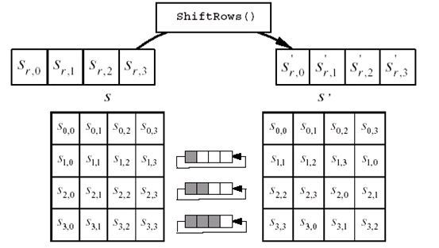
public void shiftRows(byte[] arr) { for(inti=rowSize;i< arr.length;i+=rowSize){ arr=leftRotate(arr, i,i/rowSize); } }
private byte[] leftRotate(byte[] arr, int locate,
int times) { while(times>0){ byte temp=arr[locate]; for(int i=locate;i<locate+rowSize-1;i++){ arr[i]=arr[i+1]; }
arr[locate+rowSize-1]=temp; times--; } return arr; }
shiftRows()code
1.2 shiftRows()
shiftRows() code

Slide 13
1.2 invShiftRows()
public void invShiftRows(byte[] arr) { for (int i = rowSize; i < arr.length; i+=rowSize){ arr=rightRotate(arr, i,i/4); } } private byte[]rightRotate(byte[] arr, int locate,
int times) { while(times>0){ byte temp=arr[locate+rowSize-1]; for(int i=locate+rowSize-1;i>locate;i--){ arr[i]=arr[i-1]; } arr[locate]=temp; times--; } return arr; }
public void shiftRows(byte[] arr) {
for(inti=rowSize;i< arr.length;i+=rowSize){ arr=leftRotate(arr, i,i/rowSize); } }
private byte[] leftRotate(byte[] arr, int locate,
int times) { while(times>0){ byte temp=arr[locate]; for(int i=locate;i<locate+rowSize-1;i++){ arr[i]=arr[i+1]; }
arr[locate+rowSize-1]=temp; times--; } return arr; }
invShiftRows()code
shiftRows()code

Slide 14
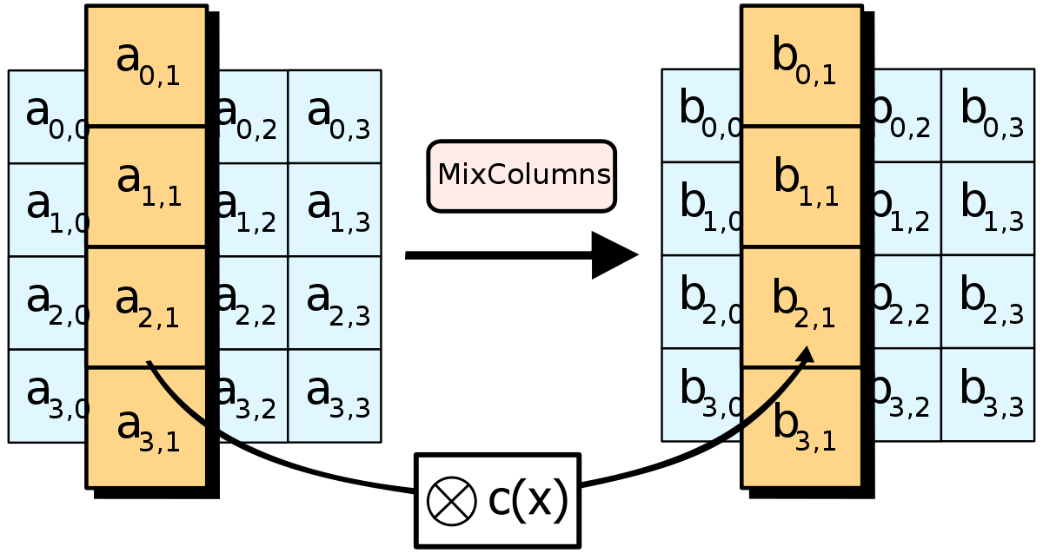
shiftRows()code
1.3 mixColumn()

Slide 15
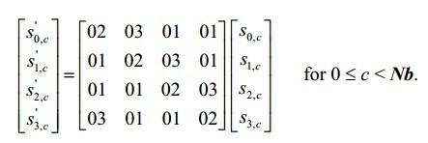
1.3 mixColumn()
private void mixColumns(byte [] arr) { byte [] temp= new byte [arr.length]; System.arraycopy(arr, 0, temp, 0, temp.length); for(int i=0;i<4;i++){ arr[i] = (byte) (slowMult(temp[i],(byte)2) ^ slowMult(temp[i+rowSize], (byte)3) ^
slowMult(temp[i+rowSize*2], (byte)1) ^ slowMult(temp[i+rowSize*3], (byte)1)); arr[i+rowSize] = (byte) (slowMult(temp[i], (byte)1) ^ slowMult(temp[i+rowSize], (byte)2) ^
slowMult(temp[i+rowSize*2],(byte)3) ^ slowMult(arr[i+rowSize*3], (byte)1)); arr[i+rowSize*2] = (byte) (slowMult(temp[i], (byte)1) ^ slowMult(temp[i+rowSize], (byte)1) ^
slowMult(temp[i+rowSize*2],(byte)2) ^ slowMult(temp[i+rowSize*3], (byte)3)); arr[i+rowSize*3] = (byte) (slowMult(temp[i], (byte)3) ^ slowMult(temp[i+rowSize], (byte)1) ^
slowMult(temp[i+rowSize*2],(byte)1) ^ slowMult(temp[i+rowSize*3], (byte)2)); } }
mixColumn()code

Slide 16
1.3 mixColumn()
private static int slowMult(byte a, byte b) { int aa = a, bb = b, r = 0, t; while (bb != 0) { if ((bb & 1) != 0) r = (r ^ aa); t = (aa & 0x80); aa = (aa << 1); if (t != 0) aa = (aa ^ 0x1b); bb = ((bb & 0xff) >> 1); } return r; }
mixColumn()code

Slide 17
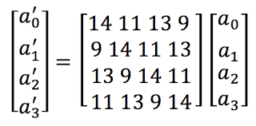
1.3 invMixColumn()
private void invMixColumns(byte[] arr) { byte [] temp= new byte [arr.length]; System.arraycopy(arr, 0, temp, 0, temp.length); for(int i=0;i<4;i++){ arr[i] = (byte) (slowMult(temp[i], (byte)14) ^ slowMult(temp[i+rowSize], (byte)11) ^
slowMult(temp[i+rowSize*2], (byte)13) ^ slowMult(temp[i+rowSize*3], (byte)9)); arr[i+rowSize] = (byte) (slowMult(temp[i], (byte)9) ^ slowMult(temp[i+rowSize], (byte)14) ^
slowMult(temp[i+rowSize*2], (byte)11) ^ slowMult(temp[i+rowSize*3], (byte)13)); arr[i+rowSize*2] = (byte) (slowMult(temp[i], (byte)13) ^ slowMult(temp[i+rowSize], (byte)9) ^
slowMult(temp[i+rowSize*2], (byte)14) ^ slowMult(temp[i+rowSize*3], (byte)11)); arr[i+rowSize*3] = (byte) (slowMult(temp[i], (byte)11) ^ slowMult(temp[i+rowSize], (byte)13) ^ slowMult(temp[i+rowSize*2], (byte)9) ^ slowMult(temp[i+rowSize*3], (byte)14)); } }
invMixColumn()code
private void mixColumns(byte [] arr) { byte [] temp= new byte [arr.length]; System.arraycopy(arr, 0, temp, 0, temp.length); for(int i=0;i<4;i++){ arr[i] = (byte) (slowMult(temp[i],(byte)2) ^ slowMult(temp[i+rowSize], (byte)3) ^
slowMult(temp[i+rowSize*2], (byte)1) ^ slowMult(temp[i+rowSize*3], (byte)1)); arr[i+rowSize] = (byte) (slowMult(temp[i], (byte)1) ^ slowMult(temp[i+rowSize], (byte)2) ^
slowMult(temp[i+rowSize*2],(byte)3) ^ slowMult(arr[i+rowSize*3], (byte)1)); arr[i+rowSize*2] = (byte) (slowMult(temp[i], (byte)1) ^ slowMult(temp[i+rowSize], (byte)1) ^
slowMult(temp[i+rowSize*2],(byte)2) ^ slowMult(temp[i+rowSize*3], (byte)3)); arr[i+rowSize*3] = (byte) (slowMult(temp[i], (byte)3) ^ slowMult(temp[i+rowSize], (byte)1) ^
slowMult(temp[i+rowSize*2],(byte)1) ^ slowMult(temp[i+rowSize*3], (byte)2)); } }

Slide 18
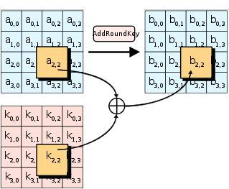
1.4 addKyes()
public void addRoundKey(byte[] bytematrix, byte[] keymatrix) { for (int i = 0; i < bytematrix.length;
i++)
{ bytematrix[i] ^= keymatrix[i]; } }
addKyes()code

Slide 19
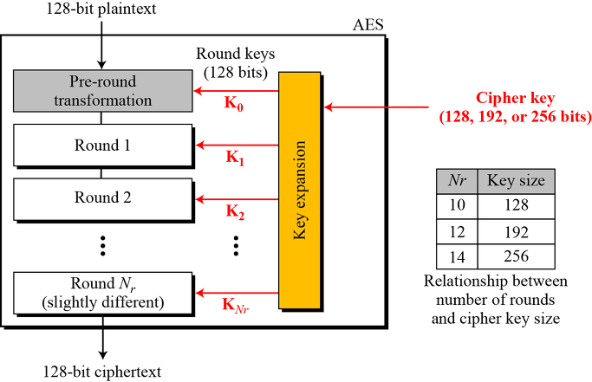
2. keySchedule()

Slide 20
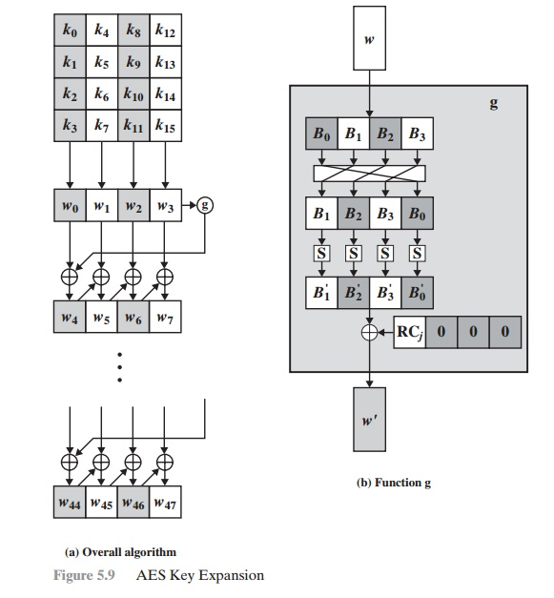
2. keySchedule()

Slide 21
2. keySchedule()
public void keyScheduleCore(int round){ //roate byte temp=roundKeys[round-1][3]; for(int i=0;i<rowSize*3;i+=rowSize){ roundKeys[round][i]=roundKeys[round-1][3+i+rowSize]; } roundKeys[round][rowSize*3]=temp; for(int i=0;i<rowSize*4;i+=rowSize){ roundKeys[round][i]=(byte) Sbox[byteToint(roundKeys[(byte)round][i])]; } roundKeys[round][0]= (byte) (roundKeys[round-1][0]^roundKeys[round][0]^rcon[round]); roundKeys[round][rowSize]= (byte) (roundKeys[round-1][rowSize]^roundKeys[round][rowSize]); roundKeys[round][rowSize*2]=(byte) (roundKeys[round-1][rowSize*2]^roundKeys[round][rowSize*2]); roundKeys[round][rowSize*3]=(byte) (roundKeys[round-1][rowSize*3]^roundKeys[round][rowSize*3]);
} public void keySchedule() { System.arraycopy(passwordBytes, 0, roundKeys[0], 0, roundKeys[0].length); for(int k=1;k<11;k++){ keyScheduleCore(k); for(int i=1;i<4;i++){ roundKeys[k][i]= (byte) (roundKeys[k-1][i]^roundKeys[k][i-1]); roundKeys[k][i+rowSize]= (byte) (roundKeys[k-1][i+rowSize]^roundKeys[k][i-1+rowSize]); roundKeys[k][i+rowSize*2]=(byte) (roundKeys[k-1][i+rowSize*2]^roundKeys[k][i-1+rowSize*2]); roundKeys[k][i+rowSize*3]=(byte) (roundKeys[k-1][i+rowSize*3]^roundKeys[k][i-1+rowSize*3]); } } }
keySchecdule() code

Slide 22
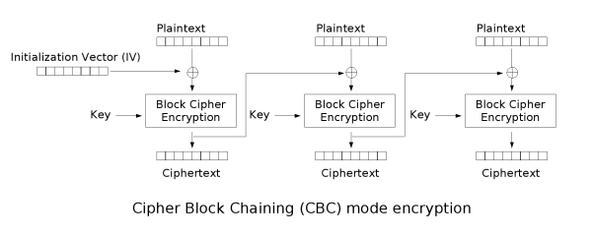
3. AES CBC Mode
문제 : AES 128 은 128bit 크기 데이터 만을 암호화 한다. 그러나 대부분의 데이터는 128bit보다 크다
해결 : 데이터를 128bit 단위로 나눈다. 대부분 정확하게 나누어 떨어지지 않으므로 패딩을 추가

Slide 23
3.1 setPassword()
public boolean setPassword(String password){ if(password.length()!=16){ System.out.print("password pass is 16 lengh"); return false; } passwordBytes= password.getBytes(); keySchedule(); return true; }
setPassword()code

Slide 24
3.2 setText()
public void setText(String plainText)
throws UnsupportedEncodingException{ byte[] b = StringToByte(plainText); //over 16 byte if(b.length%16!=0){ this.textBytes=new byte[b.length/16+1][16]; //small then 16 byte if(b.length<16){ for(int i=0;i<b.length;i++){ this.textBytes[0][i]=b[i]; } for(int i=b.length;i<16;i++){ this.textBytes[0][i]=(byte)0xff; } }
//bigger then 16 byte
else{ for(int i=0;i<b.length/16;i++){ for(int j=0;j<16;j++){ this.textBytes[i][j]=b[(i*16)+j]; } } for(int i=0;i<b.length%16;i++){ this.textBytes[b.length/16][i]=b[((b.length/16)*16)+i]; } for(int i=b.length%16;i<16;i++){ this.textBytes[b.length/16][i]=(byte)0xff; } } }
//plain text mod 16
else{ this.textBytes=new byte[b.length/16][16]; for(int i=0;i<b.length/16;i++){ for(int j=0;j<16;j++){ this.textBytes[i][j]=b[j+(i*16)]; } } } }

Slide 25
public String encrypt() throws UnsupportedEncodingException{ byte[] buffer = new byte[textBytes.length*16]; byte [] beforeCypher=new byte[16]; for(int i=0;i<16;i++){ beforeCypher[i]=(byte) i; } for(int i=0;i<textBytes.length;i++){ addRoundKey(textBytes[i], beforeCypher); encrypt128(textBytes[i]); System.arraycopy(textBytes[i], 0, buffer, i*16, 16); beforeCypher=textBytes[i]; }
return byteToString(buffer); }
3.3 encrypt()
encrypt() code

Slide 26
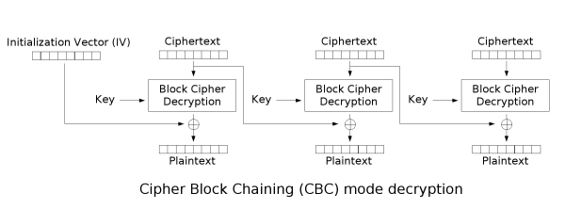
public String decrypt() throws UnsupportedEncodingException{ byte [] beforeCypher=new byte[16]; for(int i=0;i<16;i++){ beforeCypher[i]=(byte) i; } byte [] currentCypher= new byte[16];
for(int i=0;i<textBytes.length;i++){ System.arraycopy(textBytes[i], 0, currentCypher, 0, 16); decrypt128(textBytes[i]); addRoundKey(textBytes[i], beforeCypher); System.arraycopy(currentCypher, 0, beforeCypher, 0, 16); } //calculate padd size int paddSize=0; if(textBytes[textBytes.length-1][14]==(byte)0xff && textBytes[textBytes.length-1][15]==(byte)0xff){ for(int k=0;k<16;k+=2){ if(textBytes[textBytes.length-1][k]==(byte)0xff && textBytes[textBytes.length-1][k+1]==(byte)0xff) { paddSize=16-k; break; } } } //copy textBytes to buffer, except padding byte [] buffer = new byte[textBytes.length*16-paddSize]; for(int i=0;i<textBytes.length;i++){ if(i==textBytes.length-1) System.arraycopy(textBytes[i], 0, buffer,i*16, textBytes[i].length-paddSize); else System.arraycopy(textBytes[i], 0, buffer,i*16, textBytes[i].length); }
//buffer change String return byteToString(buffer); }
3.4 decrypt()
decrypt() code

